Slide 1

Object Oriented Design – Implement Simple ATM
COURSE WORK

Slide 2


What will we talk about?
Programming language – Python
OOP in Python
Implementing ATM with classes
Class explanation
Action based on classes
Database – MySQL

Slide 3
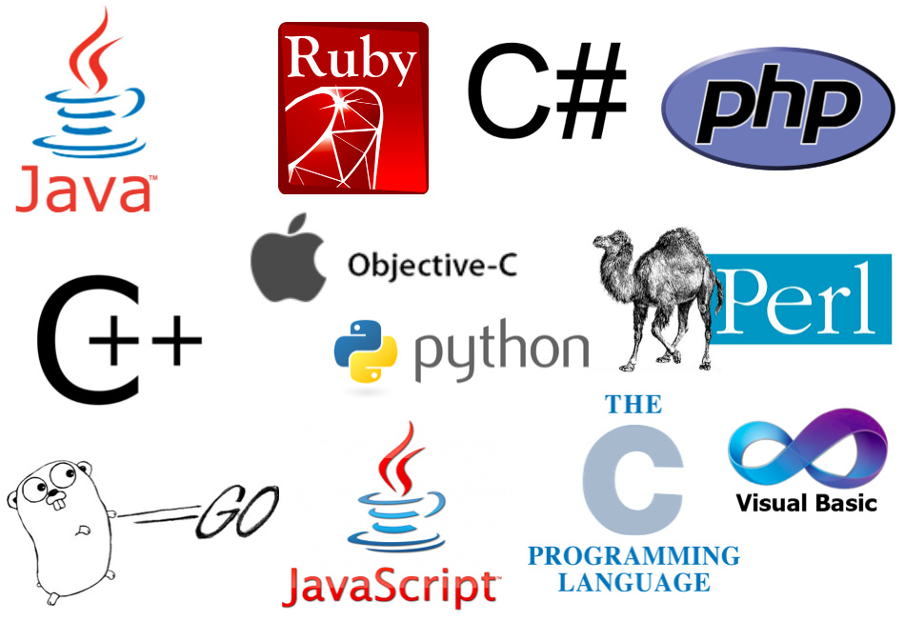
Python
Importance of programming language
Python
Interpreted language
Readability
Versatility
Extensive documentation

Slide 4
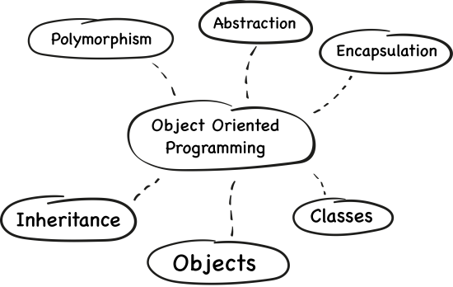
OOP CONCEPT
OOP
Encapsulation
Inheritance
Polymorphism
Benefits of OOP
OOP in Python
Let’s talk about classes ☺

Slide 5


Implementing ATM with classes
Basic idea of ATM
Classes of ATM
Our code defines three classes: Account, Bank, and ATM.

Slide 6

Class explanation
Explanation of each class
Attributes of classes

Slide 7

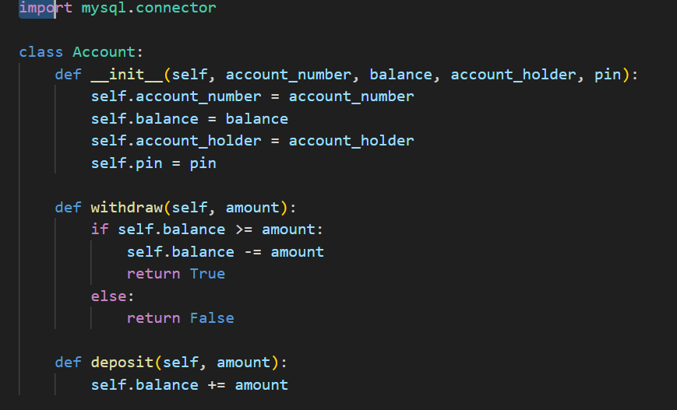
Code

Slide 8

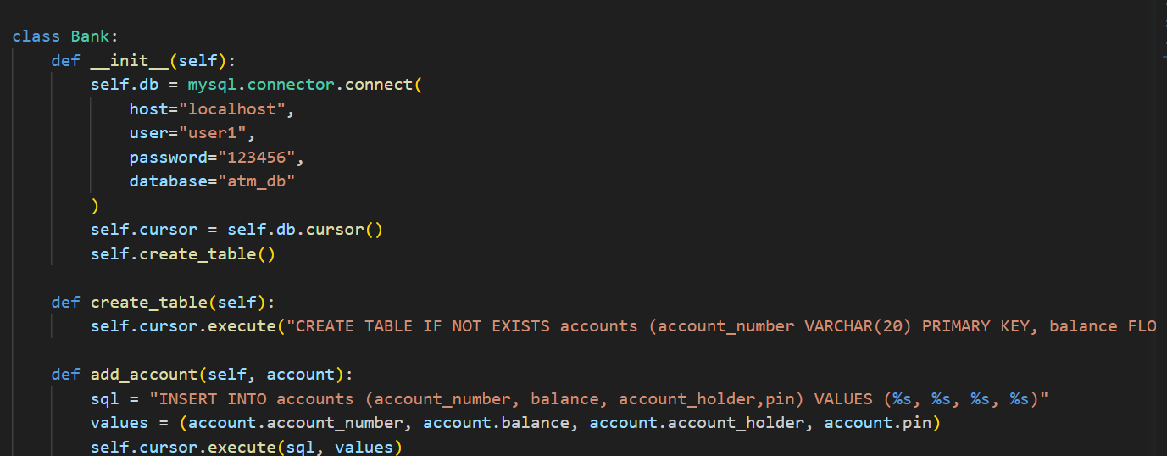
Code

Slide 9

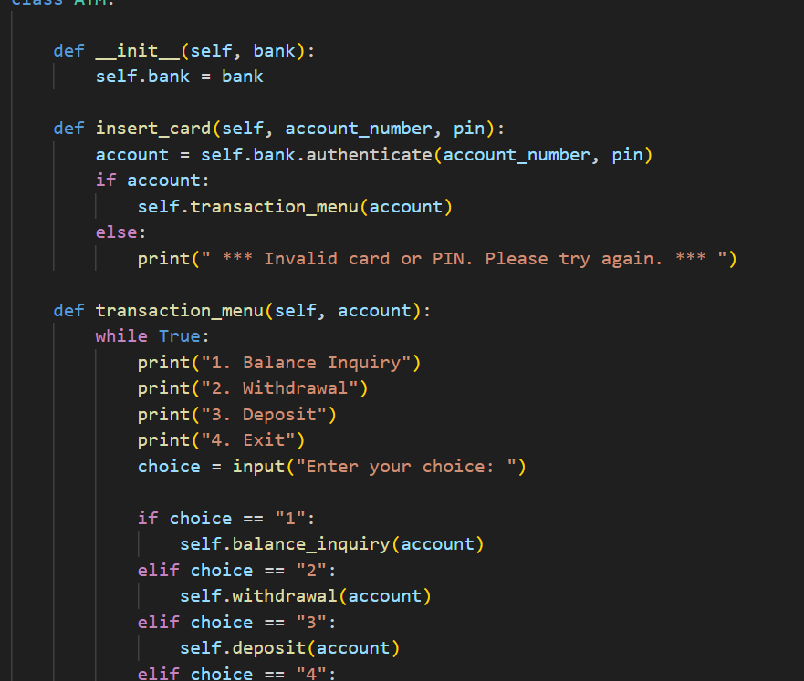
Code

Slide 10

Database
What is Database
Importance of database (MySQL)
Connection between DB and Python

Slide 11

Testing out
So, let’s jump in VSCode ☺

Slide 12

Conclusion
THANKS FOR ATTENTION!

